Slide 1
Model Inventory of Roadway Elements
Fundamental Data Elements:
New Requirements Under 23 CFR Part 924
FHWA Office of Safety
January 25, 2017

Slide 2
Highway Safety Improvement Program (HSIP) Background
Core Federal-aid program
  Purpose: achieve a significant reduction in fatalities and serious injuries on all public roads
  $2.2-2.4 billion annual apportionment
Last rulemaking update took effect: January 23, 2009

Slide 3
Why is FHWA making this change?
Provide consistency with MAP-21
and the FAST Act
Implement actions required by
the Secretary in MAP-21
Clarify existing program requirements

Slide 4
Legislative Changes and Requirements for HSIP
Items Removed (no longer exist under MAP-21)
  Transparency Report
  High Risk Rural Roads set-aside and reporting requirements
  10% flexibility provision for States to use safety funding per 23 U.S.C. 148(e)
Items Added
  State Strategic Highway Safety Plan update requirements
  Subset of model inventory of roadway elements
  HSIP reporting content and schedule

Slide 5
Regulation Structure
924.1 Purpose
924.3 Definitions
924.5 Policy
924.7 Program Structure
924.9 Planning
924.11 Implementation
924.13 Evaluation
924.15 Reporting
924.17 MIRE Fundamental Data Elements

Slide 6
Section 924.11 Implementation
The HSIP shall be implemented in accordance with the Planning requirements.
MIRE Fundamental Data Elements:
  Incorporate specific quantifiable and measurable anticipated improvements for the collection of MIRE fundamental data elements into the Traffic Records Strategic Plan by July 1, 2017
  Have access to a complete collection of MIRE FDE on all public roads by September 30, 2026
Requires SHSP include or be accompanied by actions that address how the SHSP emphasis area strategies will be implemented
Railway-Highway Crossings Program Special Rule

Slide 7
MIRE Fundamental Data Elements
(924.17 MIRE Fundamental Data Elements)
Required to comply with section 1112 of MAP-21
  Establish a subset of the model inventory elements that are useful for the inventory of roadway safety; and
  Ensure that States adopt and use the subset to improve data collection
Model Inventory of Roadway Elements (MIRE) Fundamental Data Elements (FDE)
  Needed to conduct enhanced safety analysis
  Potential to support other safety and infrastructure programs
  All public roads

Slide 8
MIRE Fundamental Data Elements
(924.17 MIRE Fundamental Data Elements)
Three Tables based on functional classification and surface type
  Non-Local Paved Roads (37 elements)
    Roadway Segments
    Intersections
    Interchanges/Ramps
  Local Paved Roads (9 elements)
    Roadway Segments
  Unpaved Roads (5 elements)
    Roadway Segments

Slide 9
Unpaved Roads Provision Under FAST Act
The FAST Act allows States to opt out of collecting MIRE FDEs on unpaved roads. They must meet two conditions:
  The States do not use HSIP funds on any unpaved road for which they do not collect the MIRE FDEs [23 U.S.C. 148(k)(A)] AND
  The States demonstrate having consulted with affected Indian tribes before ceasing to collect the data on roads included in the National Tribal Transportation Facility Inventory [23 U.S.C. 148(k)(B)]
If States choose to opt out, they must notify their FHWA Division Office via letter to the Division Administrator

Slide 10
Guidance on State Safety Data Systems
Guidance on State Safety Data Systems, including the MIRE FDE’s can be found at:
  http://safety.fhwa.dot.gov/legislationandpolicy/fast/ssds_guidance.cfm

Slide 11
How were the MIRE FDE Chosen?
Key Principles in MAP-21 & FAST Act
Highway Safety Improvement Program:
  The goal is to achieve a significant reduction in traffic fatalities and serious injuries on all public roads.
  Requires a data-driven, strategic approach to improving highway safety on all public roads that focuses on performance.

Slide 12
How were the MIRE FDE Chosen?
Key Principles in MAP-21 & FAST Act
State safety data systems should be sufficient to guide the HSIP and SHSP processes, e.g.:
  Identify fatalities and serious injuries on all public roads by location
  Safety problem identification and countermeasure analysis.
  Identify hazardous locations, sections, and elements.
  Etc.

Slide 13
How were the MIRE FDE Chosen?
Key Principles in MAP-21 & FAST Act
A State's crash, roadway, and traffic data should be able to be linked or combined by virtue of having common data elements.
  States now include as part of their annual Highway Performance Monitoring System (HPMS) data submission a linear reference system network
  That network is one means to geolocate all safety data on a common highway basemap that includes all public roads.

Slide 14
How were the MIRE FDE Chosen?
FDEs Should Enable Agencies to:
Define roadway segments, intersections and interchanges/ramps
Delineate basic information needed to characterize the roadway type and exposure
Identify governmental ownership and functional classification consistent with the HSIP reporting requirements

Slide 15
MIRE FDE for Roadway Segments on Non-Local Paved Roads (Table 1 in 23 CFR 924)
Segment Identifier
Route Number*
Route/Street Name*
Federal Aid/Route Type*
Rural/Urban Designation*
Surface Type*
Begin Point Segment Descriptor*
End Point Segment Descriptor*
Segment Length*
Direction of Inventory
Functional Class*
Median Type
Access Control*
One/Two-Way Operations*
Number of Through Lanes*
AADT*
AADT Year*
Type of Governmental
Ownership*
* – HPMS full extent elements

Slide 16
MIRE FDE for Roadway Segments on Local Paved Roads (Table 2 in 23 CFR 924)
Segment Identifier
Rural/Urban Designation
Surface Type
Begin Point Segment Descriptor
End Point Segment Descriptor
Functional Class
Number of Through Lanes
AADT
Type of Governmental
Ownership

Slide 17
MIRE FDE for Roadway Segments on Unpaved Roads (Table 3 in 23 CFR 924)
Segment Identifier
Begin Point Segment Descriptor
End Point Segment Descriptor
Functional Class
Type of Governmental
Ownership

Slide 18
MIRE FDE for Intersections
(Non-local paved roads, Table 1 in 23 CFR 924)
Unique Junction Identifier
Location Identifier for Road 1 Crossing Point
Location Identifier for Road 2 Crossing Point
Intersection/Junction Geometry
Intersection/Junction Traffic Control
AADT [for each Intersecting Road]
AADT Year [for each Intersecting Road]
Unique Approach Identifier

Slide 19
MIRE FDE for Interchanges/Ramps
(Non-local Paved Roads, Table 1 in 23 CFR 924)
Unique Interchange Identifier
Location Identifier for Roadway at Beginning Ramp Terminal
Location Identifier for Roadway at Ending Ramp Terminal
Ramp Length
Roadway Type at Beginning Ramp Terminal
Roadway Type at Ending Ramp Terminal
Interchange Type
Ramp AADT*
Year of Ramp AADT*
Functional Class*
Type of Governmental Ownership*
LEGEND
* – HPMS full extent elements

Slide 20
Reliability of Safety Management Methods: Network Screening
Comparison of economic effectiveness of alternative network screening methods.
Expected average crash frequency consistently yielded more economically efficient set of projects.
http://safety.fhwa.dot.gov/rsdp/downloads/fhwasa16037.pdf

Slide 21
MIRE FDE Implementation Dates
July 1, 2017 – Incorporate specific quantifiable and measurable anticipated improvements that prioritizes the collection of MIRE FDE into the Traffic Records Strategic Plan
September 30, 2026 – Access to a complete collection of MIRE FDE on all public roads

Slide 22
July 1, 2017 Traffic Records Strategic Plan
Strategies States should consider for the July 1, 2017 report:
  The current status of MIRE FDE collection efforts (i.e. FDEs currently maintained (or not) in the roadway inventory as well as the public roads for which the FDEs are collected.)
  Appropriate data collection methodology
  Coordination with other agencies (within State, local, and tribal jurisdictions)
  Prioritization criteria for collecting the FDEs on all public roads
  The schedule and estimated costs for data collection efforts.

Slide 23
July 1, 2017 Traffic Records Strategic Plan
The result of this planning effort should be a specific, measurable, achievable, realistic and time-bound strategies for the collection, maintenance and management of the FDEs by September 30, 2026.

Slide 24
Technical Assistance
Roadway Data Improvement Program (RDIP)
Roadway Data Extraction Technical Assistance Program (RDETAP)
Safety Data and Analysis Technical Assistance
Local Data Integration Technical Assistance
Safety Data Management and Governance Technical Assistance

Slide 25
Resources
FHWA Roadway Safety Data Program Web Site and Toolbox:
  http://safety.fhwa.dot.gov/rsdp/
MIRE Resources:
  http://safety.fhwa.dot.gov/rsdp/mire.aspx
HSIP Resources:
  http://safety.fhwa.dot.gov/hsip/

Slide 26
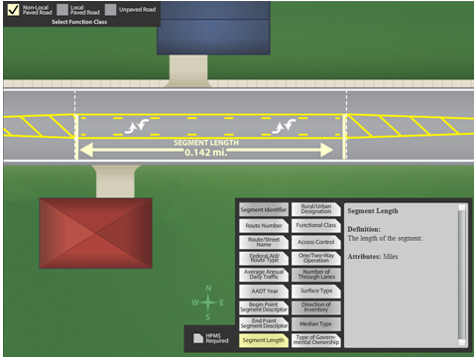
MIRE FDE Graphics

Slide 27
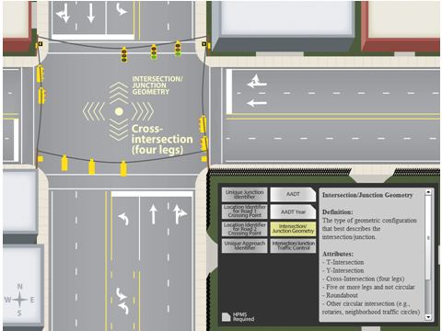
MIRE FDE Graphics

Slide 28
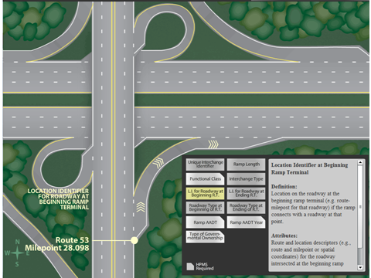
MIRE FDE Graphics

Slide 29
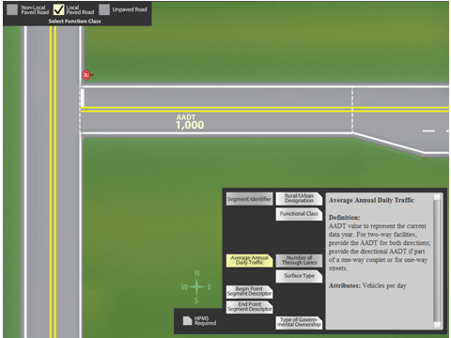
MIRE FDE Graphics

Slide 30
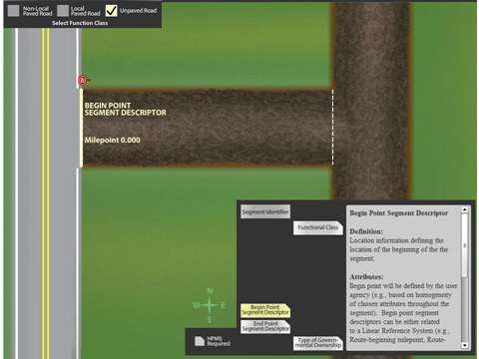
MIRE FDE Graphics

Slide 31
MIRE FDE Contacts
Robert Pollack
  Robert.Pollack@dot.gov
  202-366-5019
Ray Krammes
  Ray.Krammes@dot.gov
  202-366-2175

Slide 32
AADT Process for HPMS
Traffic Data Reporting
Steven Jessberger
Travel Monitoring and Surveys Section
FHWA Office of Highway Policy Information

Slide 33
AADT Definition
A
Annual
A
Average
D
Daily
T
Traffic
Annual Average Daily Traffic (AADT) identifies the average volume of traffic for the average one day (24-hour period) during a data reporting year at a specific location or specific segment of road.
Directly from a continuous count site (CCS)
Factored from a short duration count

Slide 34
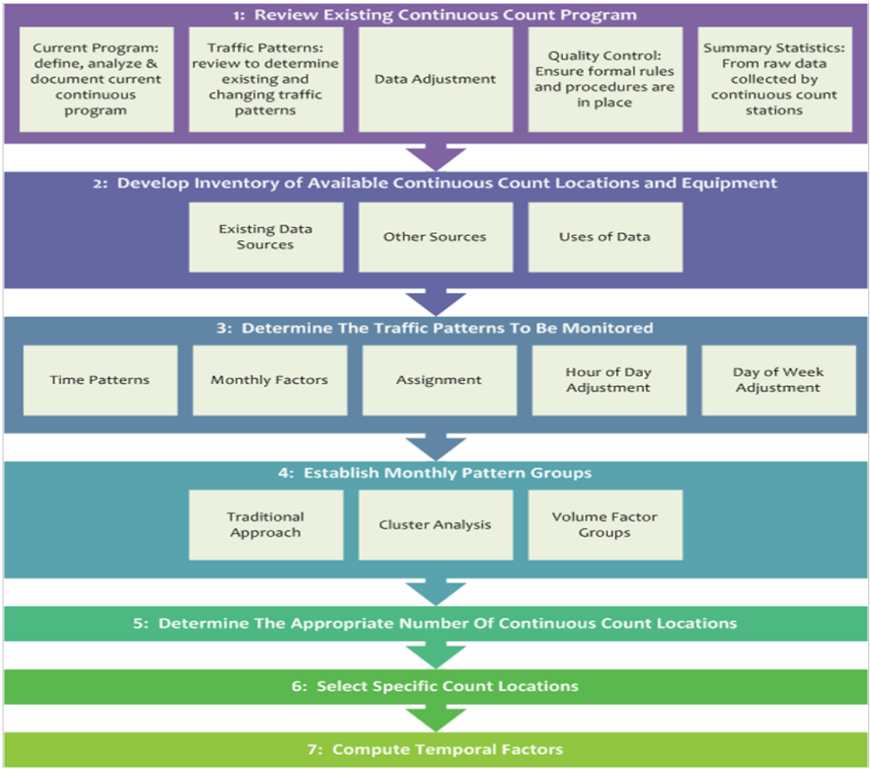
Steps for Establishing a Permanent Count Program

Slide 35
HPMS Functional Classification (FC) Roadways Already Reported
FC | Urban | Rural
1 | Interstate – Principal Arterial | Interstate– Principal Arterial
2 | Principal Arterial – Other Freeway Expressway | Principal Arterial – Other Freeway Expressway
3 | Principal Arterial - Other | Principal Arterial - Other
4 | Minor Arterial | Minor Arterial
5 | Major Collector | Major Collector
6 | Minor Collector | Minor Collector
7 | Local | Local
Green areas – AADT must be reported in HPMS for State Federal Aid System
Rose Areas – no AADT reporting requirement for HPMS

Slide 36
HPMS ADT Duration Requirements
All classification portable short term counts shall be 48 hour or longer durations.
All volume traffic data reported for HPMS should be based on a minimum of 24-hour counts for roads with volumes greater than 5,000 AADT and 48-hour counts for roads where volumes are less than 5,000 AADT.
2016 Traffic Monitoring Guide (TMG), page 6-7

Slide 37
Traffic Monitoring Guide (TMG)
AADT Factoring Requirements
Factors that must be applied to convert all short duration traffic counts (ADT) to Annual Average Daily Traffic (AADT):
  Axle Correction Factors (ACF) if data is obtained from single road tubes or axle sensors (obtained from WIM or per vehicle class data)
  Hour of day (HOD) if partial day counts are obtained
  Day of Week (DOW) if less than 7 day counts are obtained
  Month of Year (MOY) applied to all portable counts
  Year over year factors for other than yearly obtained portable counts (all data should be reported as if for the current year)

Slide 38
Factoring Group Recommendations
Minimum of 6 Continuous Count Stations (CCS) per group (usually range from 6 to 8)
Variability of Permanent Site Data
(coefficient of variation)
  Urban: <10%
  Rural: 10% to 25%

Slide 39
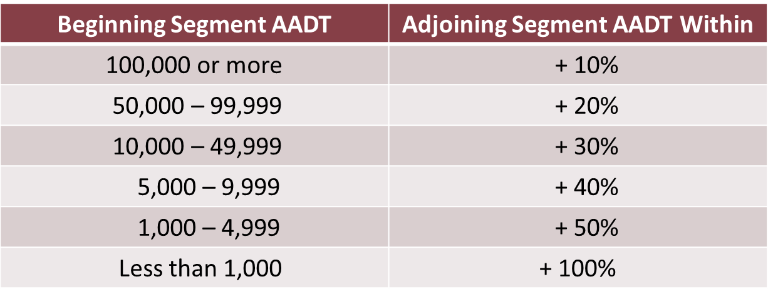
Percentage-Based Rules of Thumb for Segment to Segment Allowable Changes
Generally the lower the functionally classified roadway the larger the expected variance in AADT from segment to segment.

Slide 40
HPMS Questions: Steven Jessberger
202-366-5052 steven.jessberger@dot.gov
HPMS Useful Links:
2016 TMG website:
  http://www.fhwa.dot.gov/policyinformation/tmguide/
HPMS Field Manual website:
  http://www.fhwa.dot.gov/policyinformation/hpms/fieldmanual/
FHWA AADT study website:
  http://www.fhwa.dot.gov/policyinformation/travel_monitoring/pubs/aadt/

Slide 41
MIRE FDE
Traffic Volume Study
Stuart Thompson
FHWA Office of Safety

Slide 42
Traffic Volume Collection
HPMS standards
Collection interval
Collection duration
Methods other than counts
Estimation

Slide 43
Traffic Volume Study
A project to develop an Informational Guide on data collection, computation, and estimation of AADT for Non – Federal Aid roads.
Literature reviews
Case studies
Pilot studies
Informational guide
Peer exchange

Slide 44
MIRE FDE Traffic Volume Study Contact
Stuart Thompson, FHWA Office of Safety
  Stuart.Thompson@dot.gov
  202-366-8090

Slide 45
Question & Answer Period
FHWA Office of Safety:
Bob Pollack
Ray Krammes
Stuart Thompson
Office of Highway Policy Information:
Steven Jessberger

Slide 46
Questions You Have for Us?
????

Slide 47
Questions We Have for You?
Are you clear on what your State needs to do to collect and use the MIRE FDE?
Is your State on target to include needed MIRE FDE improvements in your July 1, 2017 Traffic Records Strategic Plan submission?
What, if any, questions/issues/concerns is your State having with MIRE FDE requirement?
Are there noteworthy practices in your State related to the MIRE FDE?

Slide 48
MIRE FDE Contacts
Robert Pollack
  Robert.Pollack@dot.gov
  202-366-5019
Ray Krammes
  Ray.Krammes@dot.gov
  202-366-2175

